Slide 1
BA Experience Dashboard
File created on: 5/3/2024 5:41:01 AM

Slide 2
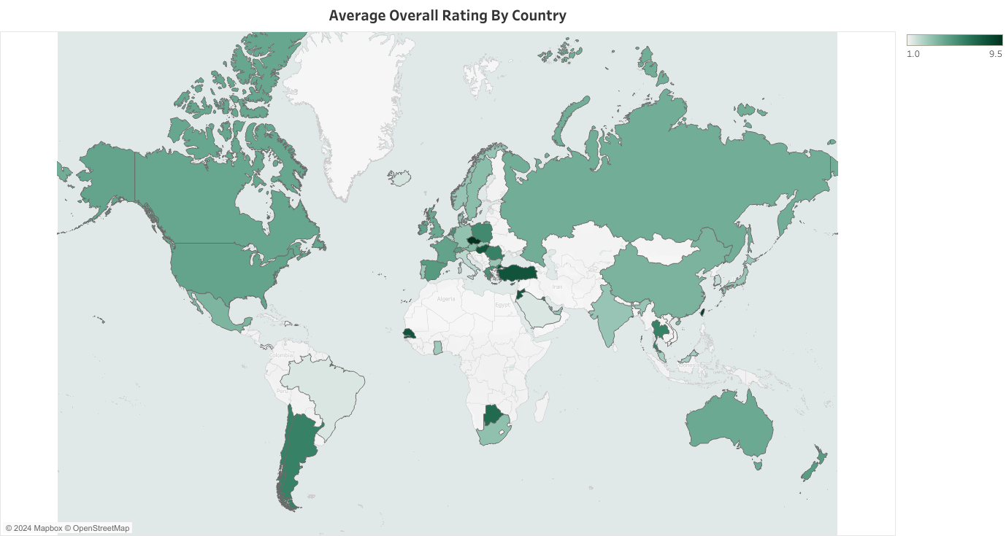

Slide 5
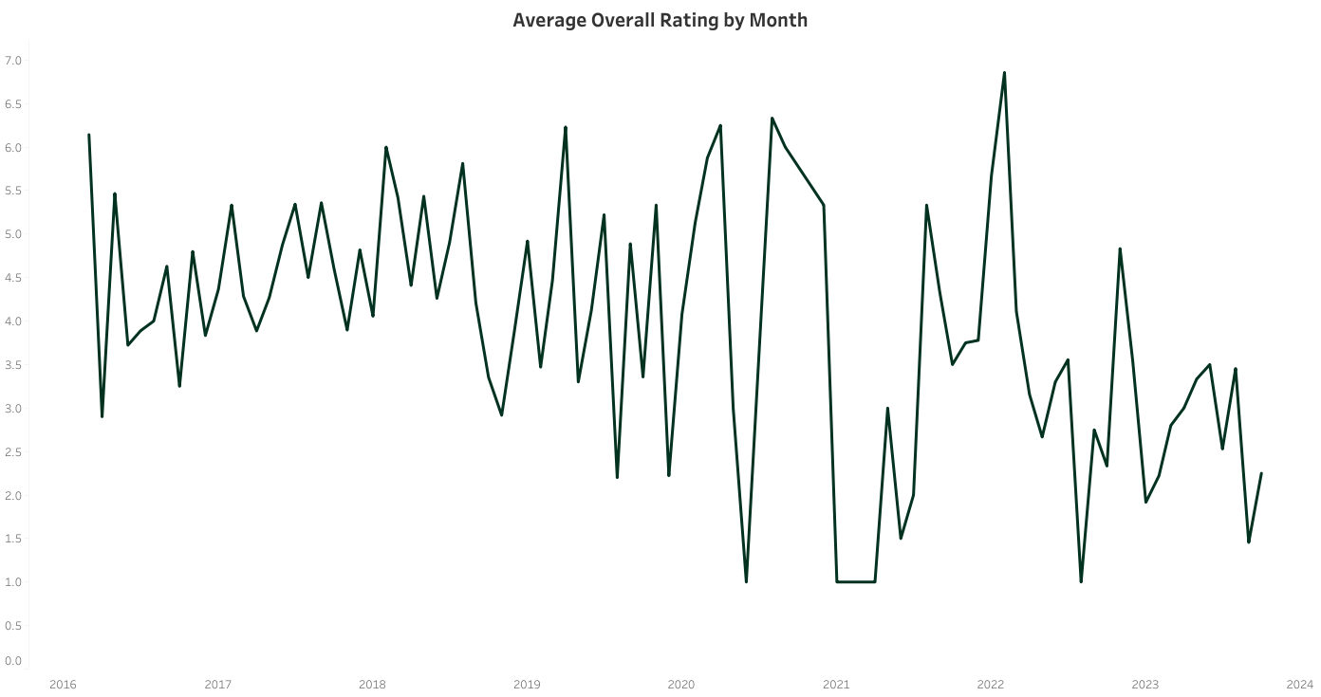

Slide 6
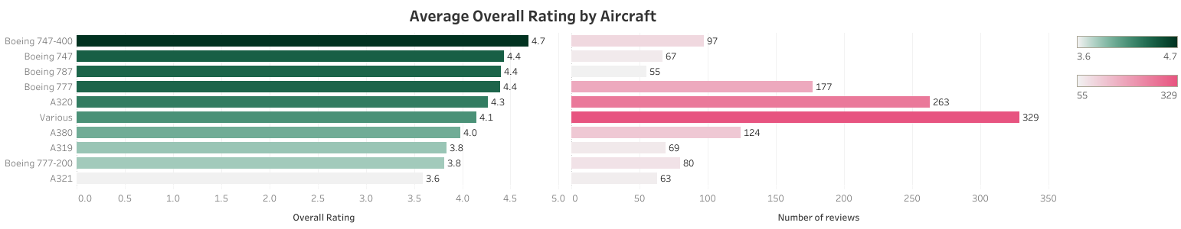

Slide 7
